Slide 1
Texture Mapping

Slide 2
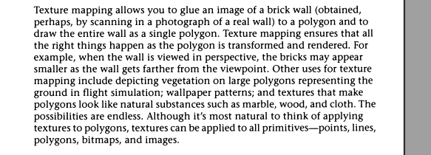

Slide 3
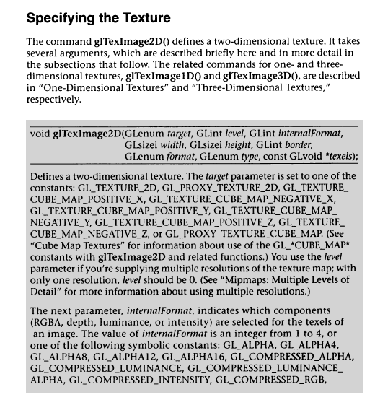

Slide 4
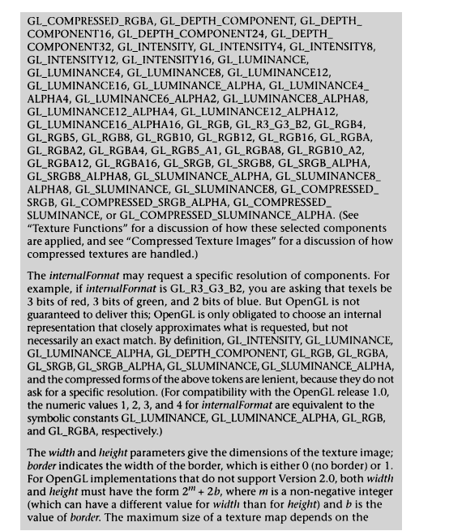

Slide 5
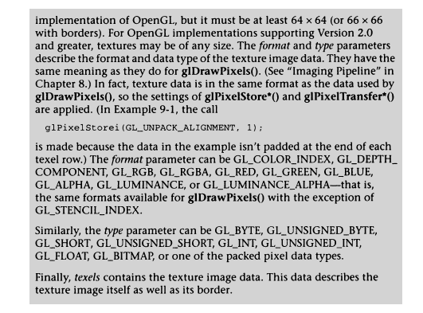
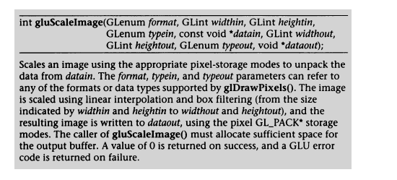

Slide 6
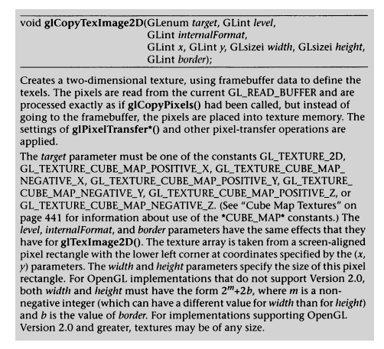
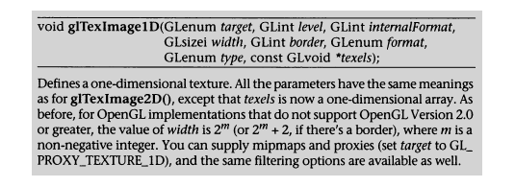

Slide 7
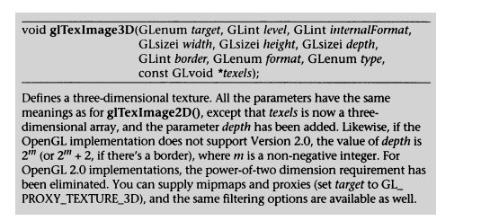
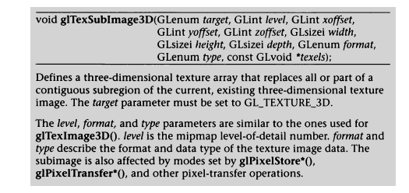

Slide 8
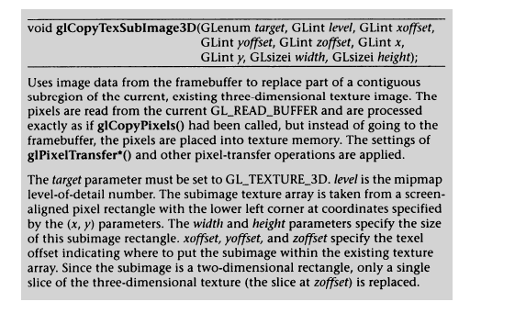

Slide 9
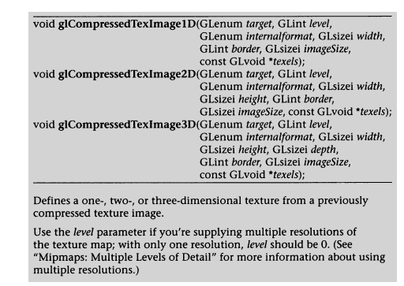

Slide 10
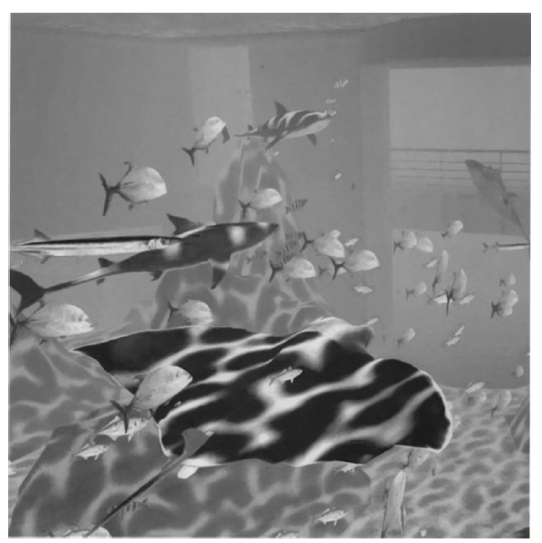

Slide 11
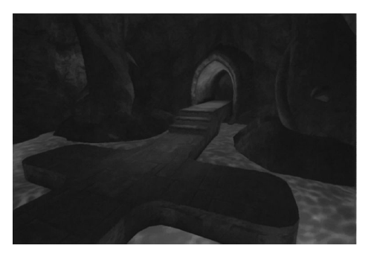
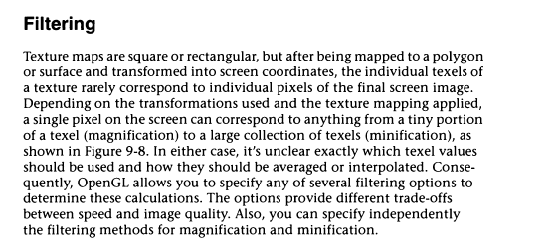

Slide 12
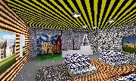
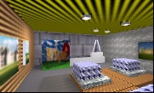
No filtering:
MIP-map texturing:

Slide 13
Magnification and Minification
More than one texel can cover a pixel (minification) or
more than one pixel can cover a texel (magnification)
Can use point sampling (nearest texel) or linear filtering
( 2 x 2 filter) to obtain texture values
Texture
Polygon
Texture
Polygon
Magnification
Minification

Slide 14
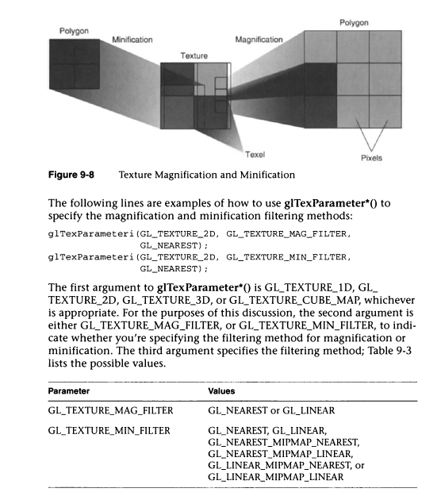

Slide 15
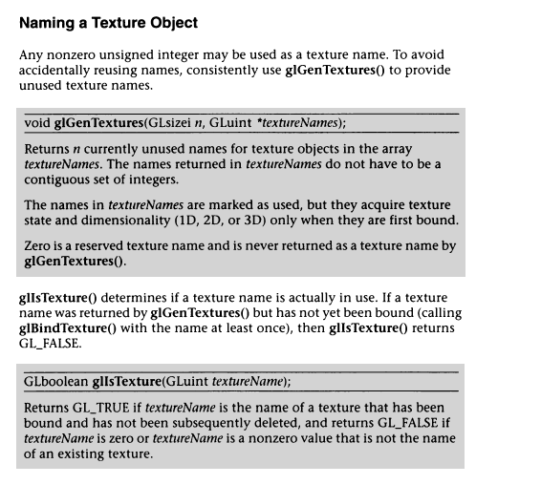

Slide 16
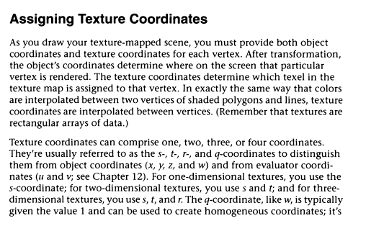

Slide 17
Mapping a Texture
Based on parametric texture coordinates
glTexCoord*() specified at each vertex
Texture Space
Object Space
t
1, 1
(s, t) = (0.2, 0.8)
0, 1
A
a
c
(0.4, 0.2)
b
B
C
0, 0
1, 0
s
(0.8, 0.4)

Slide 18
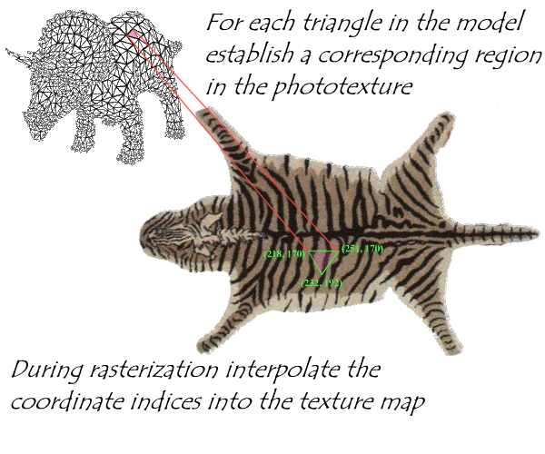

Slide 19
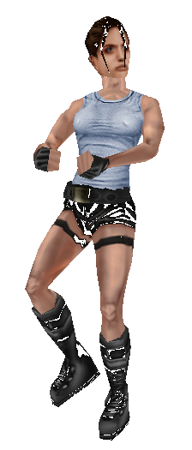
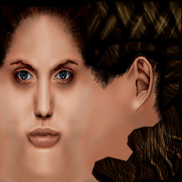
For complex 3-D objects, mapping textures is still something of an art…so we often let the user do it

Slide 20
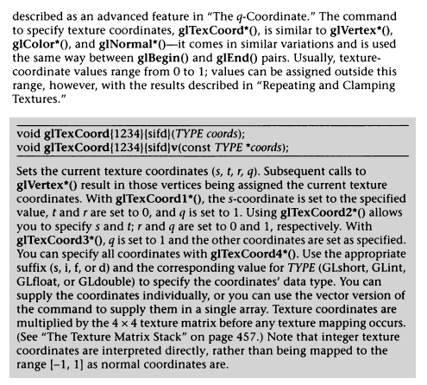

Slide 21
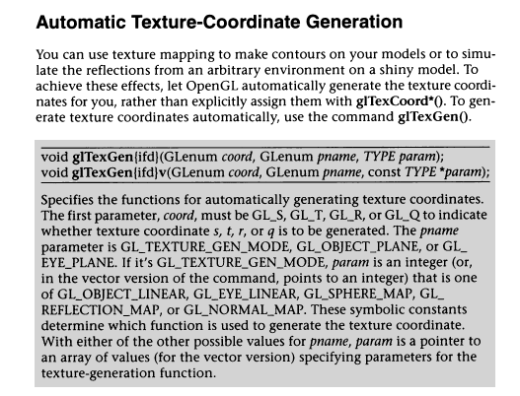

Slide 22
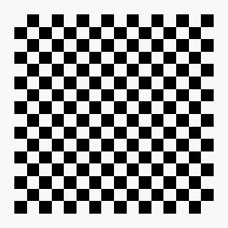
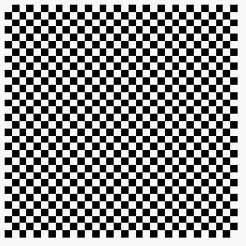

Wrapping Mode
Clamping: if s,t > 1 use 1, if s,t <0 use 0
Wrapping: use s,t modulo 1
  glTexParameteri( GL_TEXTURE_2D,
  GL_TEXTURE_WRAP_S, GL_CLAMP )
  glTexParameteri( GL_TEXTURE_2D,
  GL_TEXTURE_WRAP_T, GL_REPEAT )
t
s
GL_REPEAT
wrapping
GL_CLAMP
wrapping
texture

Slide 23
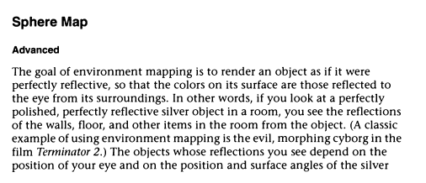

Slide 24
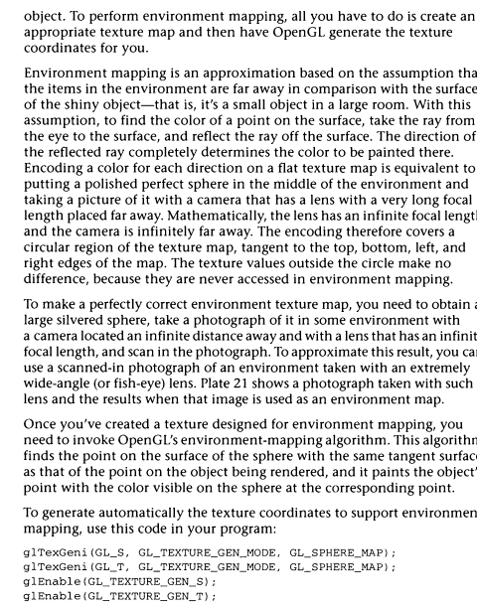

Slide 25
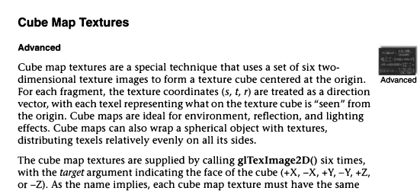
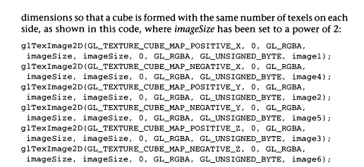

Slide 26
#include <stdlib.h>
#include <stdio.h>
#include <math.h>
#include <glut.h>
#include "bitmap.c"
BITMAPINFO *TexInfo; /* Texture bitmap information */
GLubyte *TexBits; /* Texture bitmap pixel bits */
GLint spinx = 0;
GLint spiny = 0;
GLubyte *LoadDIBitmap(const char *filename,BITMAPINFO **info);
void init(void)
{
glEnable(GL_DEPTH_TEST);
glShadeModel(GL_SMOOTH);
glClearColor(0.0, 1.0, 1.0, 0.0);

Slide 27
glTexParameteri(GL_TEXTURE_2D, GL_TEXTURE_WRAP_S, GL_REPEAT);
glTexParameteri(GL_TEXTURE_2D, GL_TEXTURE_WRAP_T, GL_REPEAT);
glTexParameteri(GL_TEXTURE_2D, GL_TEXTURE_MAG_FILTER, GL_LINEAR);
glTexParameteri(GL_TEXTURE_2D, GL_TEXTURE_MIN_FILTER, GL_LINEAR);
glTexImage2D(GL_TEXTURE_2D, 0, 3, TexInfo->bmiHeader.biWidth,
TexInfo->bmiHeader.biHeight, 0, GL_BGR_EXT, GL_UNSIGNED_BYTE, TexBits);
glTexEnvf(GL_TEXTURE_ENV, GL_TEXTURE_ENV_MODE, GL_MODULATE);
glEnable(GL_TEXTURE_2D);
}

Slide 28
int main(int argc, char** argv)
{
TexBits = LoadDIBitmap("a1.bmp", &TexInfo);

Slide 29


Slide 30
#define _CRT_SECURE_NO_WARNINGS
#include <stdlib.h>
#include <stdio.h>
#include <glut.h>
#include <math.h>
#include "bitmap.c"
BITMAPINFO *TexInfo; /* Texture bitmap information */
GLubyte *TexBits; /* Texture bitmap pixel bits */
GLint spinx = 0;
GLint spiny = 0;
GLubyte *LoadDIBitmap(const char *filename, BITMAPINFO **info);

Slide 31
void init(void){
glEnable(GL_DEPTH_TEST);
glShadeModel(GL_SMOOTH);
glClearColor(0.0, 1.0, 1.0, 0.0);
glTexParameteri(GL_TEXTURE_2D, GL_TEXTURE_WRAP_S, GL_REPEAT);
glTexParameteri(GL_TEXTURE_2D, GL_TEXTURE_WRAP_T, GL_REPEAT);
glTexParameteri(GL_TEXTURE_2D, GL_TEXTURE_MAG_FILTER, GL_LINEAR);
glTexParameteri(GL_TEXTURE_2D, GL_TEXTURE_MIN_FILTER, GL_LINEAR);
glTexImage2D(GL_TEXTURE_2D, 0, 3, TexInfo->bmiHeader.biWidth,
TexInfo->bmiHeader.biHeight, 0, GL_BGR_EXT,
GL_UNSIGNED_BYTE, TexBits);
glTexEnvf(GL_TEXTURE_ENV, GL_TEXTURE_ENV_MODE, GL_MODULATE);
glEnable(GL_TEXTURE_2D);
}

Slide 32
void display(void)
{
glClear(GL_COLOR_BUFFER_BIT | GL_DEPTH_BUFFER_BIT);
glPushMatrix();
glRotatef((GLfloat)spinx, 1.0, 0.0, 0.0);
glRotatef((GLfloat)spiny, 0.0, 0.0, 1.0);
glutSolidTeapot(0.5f);
glPopMatrix();
glFlush();
}

Slide 33
void reshape(int w, int h){
glViewport(0, 0, (GLsizei)w, (GLsizei)h);
glMatrixMode(GL_PROJECTION);
glLoadIdentity();
if (w <= h)
glOrtho(-0.6, 0.6, -0.60*(GLfloat)h / (GLfloat)w,
0.60*(GLfloat)h / (GLfloat)w, -0.60, 0.60);
else
glOrtho(-1.60*(GLfloat)w / (GLfloat)h,
0.60*(GLfloat)w / (GLfloat)h, -0.60, 0.60, -0.60, 0.60);
glMatrixMode(GL_MODELVIEW);
}

Slide 34
void mouse(int button, int state, int x, int y) {
switch (button) {
case GLUT_LEFT_BUTTON:
switch (state) {
case GLUT_DOWN:
spinx = (spinx + 5) % 360;
glutPostRedisplay(); break;
default: break;
}
break;
case GLUT_MIDDLE_BUTTON:
switch (state) {
case GLUT_DOWN:
spiny = (spiny + 5) % 360;
glutPostRedisplay(); break;
default: break;
}
break;
case GLUT_RIGHT_BUTTON:
switch (state) {
case GLUT_UP:
exit(0); break;
default: break;
}
break;
default: break;
}
}

Slide 35
int main(int argc, char** argv)
{
TexBits = LoadDIBitmap("a1.bmp", &TexInfo);
glutInit(&argc, argv);
glutInitDisplayMode(GLUT_SINGLE | GLUT_RGB | GLUT_DEPTH);
glutInitWindowSize(500, 500);
glutCreateWindow(argv[0]);
init();
glutReshapeFunc(reshape);
glutDisplayFunc(display);
glutMouseFunc(mouse);
glutMainLoop();
return 0;
}

Slide 37
#define _CRT_SECURE_NO_WARNINGS
#include <stdlib.h>
#include <stdio.h>
#include <math.h>
#include <glut.h>
#include "bitmap.c"
BITMAPINFO *TexInfo, *TexInfo2; /* Texture bitmap information */
GLubyte *TexBits, *TexBits2; /* Texture bitmap pixel bits */
static GLuint texName[2];
float xRot = 0;
float yRot = 0;
float zRot = 0;
int xAbs, yAbs;
GLint spinx = 0;
GLint spiny = 0;
GLubyte *LoadDIBitmap(const char *filename, BITMAPINFO **info);

Slide 38
void init(void){
glEnable(GL_DEPTH_TEST);
glShadeModel(GL_SMOOTH);
glClearColor(0.0, 1.0, 1.0, 0.0);
glGenTextures(2, texName);
glBindTexture(GL_TEXTURE_2D, texName[0]);
glTexParameteri(GL_TEXTURE_2D, GL_TEXTURE_MAG_FILTER, GL_LINEAR);
glTexParameteri(GL_TEXTURE_2D, GL_TEXTURE_MIN_FILTER, GL_LINEAR);
glTexImage2D(GL_TEXTURE_2D, 0, 3, TexInfo->bmiHeader.biWidth,
TexInfo->bmiHeader.biHeight, 0, GL_BGR_EXT,
GL_UNSIGNED_BYTE, TexBits);
glTexEnvf(GL_TEXTURE_ENV, GL_TEXTURE_ENV_MODE, GL_MODULATE);

Slide 39
glBindTexture(GL_TEXTURE_2D, texName[1]);
glTexParameteri(GL_TEXTURE_2D, GL_TEXTURE_MAG_FILTER, GL_LINEAR);
glTexParameteri(GL_TEXTURE_2D, GL_TEXTURE_MIN_FILTER, GL_LINEAR);
glTexImage2D(GL_TEXTURE_2D, 0, 3, TexInfo2->bmiHeader.biWidth,
TexInfo2->bmiHeader.biHeight, 0, GL_BGR_EXT,
GL_UNSIGNED_BYTE, TexBits2);
glTexEnvf(GL_TEXTURE_ENV, GL_TEXTURE_ENV_MODE, GL_MODULATE);
glEnable(GL_TEXTURE_2D);
}/

Slide 40
GLvoid glDrawCube()
{
glBindTexture(GL_TEXTURE_2D, texName[0]);
glBegin(GL_QUADS);
// Front Face
glNormal3f(0.0f, 0.0f, 0.5f);
glTexCoord2f(0.0f, 0.0f); glVertex3f(-1.0f, -1.0f, 1.0f);
glTexCoord2f(1.0f, 0.0f); glVertex3f(1.0f, -1.0f, 1.0f);
glTexCoord2f(1.0f, 1.0f); glVertex3f(1.0f, 1.0f, 1.0f);
glTexCoord2f(0.0f, 1.0f); glVertex3f(-1.0f, 1.0f, 1.0f);
// Back Face
glNormal3f(0.0f, 0.0f, -0.5f);
glTexCoord2f(1.0f, 0.0f); glVertex3f(-1.0f, -1.0f, -1.0f);
glTexCoord2f(1.0f, 1.0f); glVertex3f(-1.0f, 1.0f, -1.0f);
glTexCoord2f(0.0f, 1.0f); glVertex3f(1.0f, 1.0f, -1.0f);
glTexCoord2f(0.0f, 0.0f); glVertex3f(1.0f, -1.0f, -1.0f);
glEnd();

Slide 41
glBindTexture(GL_TEXTURE_2D, texName[1]);
glBegin(GL_QUADS);
// Top Face
glNormal3f(0.0f, 0.5f, 0.0f);
glTexCoord2f(0.0f, 1.0f); glVertex3f(-1.0f, 1.0f, -1.0f);
glTexCoord2f(0.0f, 0.0f); glVertex3f(-1.0f, 1.0f, 1.0f);
glTexCoord2f(1.0f, 0.0f); glVertex3f(1.0f, 1.0f, 1.0f);
glTexCoord2f(1.0f, 1.0f); glVertex3f(1.0f, 1.0f, -1.0f);
// Bottom Face
glNormal3f(0.0f, -0.5f, 0.0f);
glTexCoord2f(1.0f, 1.0f); glVertex3f(-1.0f, -1.0f, -1.0f);
glTexCoord2f(0.0f, 1.0f); glVertex3f(1.0f, -1.0f, -1.0f);
glTexCoord2f(0.0f, 0.0f); glVertex3f(1.0f, -1.0f, 1.0f);
glTexCoord2f(1.0f, 0.0f); glVertex3f(-1.0f, -1.0f, 1.0f);
glEnd();

Slide 42
glBindTexture(GL_TEXTURE_2D, texName[0]);
glBegin(GL_QUADS);
// Right Face
glNormal3f(0.5f, 0.0f, 0.0f);
glTexCoord2f(1.0f, 0.0f); glVertex3f(1.0f, -1.0f, -1.0f);
glTexCoord2f(1.0f, 1.0f); glVertex3f(1.0f, 1.0f, -1.0f);
glTexCoord2f(0.0f, 1.0f); glVertex3f(1.0f, 1.0f, 1.0f);
glTexCoord2f(0.0f, 0.0f); glVertex3f(1.0f, -1.0f, 1.0f);
// Left Face
glNormal3f(-0.5f, 0.0f, 0.0f);
glTexCoord2f(0.0f, 0.0f); glVertex3f(-1.0f, -1.0f, -1.0f);
glTexCoord2f(1.0f, 0.0f); glVertex3f(-1.0f, -1.0f, 1.0f);
glTexCoord2f(1.0f, 1.0f); glVertex3f(-1.0f, 1.0f, 1.0f);
glTexCoord2f(0.0f, 1.0f); glVertex3f(-1.0f, 1.0f, -1.0f);
glEnd();
}

Slide 43
void display(void)
{
glClear(GL_COLOR_BUFFER_BIT | GL_DEPTH_BUFFER_BIT);
glPushMatrix();
glRotatef(xRot, 1.0f, 0.0f, 0.0f);
glRotatef(yRot, 0.0f, 1.0f, 0.0f);
glRotatef(zRot, 0.0f, 0.0f, 1.0f);
glDrawCube();
glPopMatrix();
glFlush();
}

Slide 44
void reshape(int w, int h)
{
glViewport(0, 0, (GLsizei)w, (GLsizei)h);
glMatrixMode(GL_PROJECTION);
glLoadIdentity();
if (w <= h)
glOrtho(-2.6, 2.6, -2.60*(GLfloat)h / (GLfloat)w,
2.60*(GLfloat)h / (GLfloat)w, -2.60, 2.60);
else
glOrtho(-2.60*(GLfloat)w / (GLfloat)h,
2.60*(GLfloat)w / (GLfloat)h, -2.60, 2.60, -2.60, 2.60);
glMatrixMode(GL_MODELVIEW);
}

Slide 45
void MouseMove(int x, int y){
// the x and y values affect the opposite axis values
// because each is rotation "about an axis", not in a direction
xRot += (y - yAbs); // turn left or right
yAbs = y; // refresh our x value
yRot += (x - xAbs); // rotate up or down
xAbs = x; // refresh our y value
// Check x,y rotation values to keep 0-355
if (xRot > 360.0f)
xRot -= 360.0f;
if (xRot < 0.0f)
xRot += 360.0f;
if (yRot > 360.0f)
yRot -= 360.0f;
if (yRot < 0.0f)
yRot += 360.0f;
glutPostRedisplay(); // Refresh the window
}

Slide 46
int main(int argc, char** argv){
TexBits = LoadDIBitmap("marble.bmp", &TexInfo);
TexBits2 = LoadDIBitmap("skin02.bmp", &TexInfo2);
glutInit(&argc, argv);
glutInitDisplayMode(GLUT_SINGLE | GLUT_RGB | GLUT_DEPTH);
glutInitWindowSize(500, 500);
glutCreateWindow(argv[0]);
init();
glutReshapeFunc(reshape);
glutDisplayFunc(display);
glutMotionFunc(MouseMove);
glutMainLoop();
return 0;
}

Slide 49
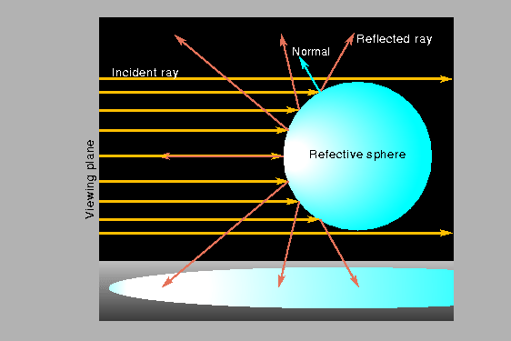
Sphere map

Slide 50
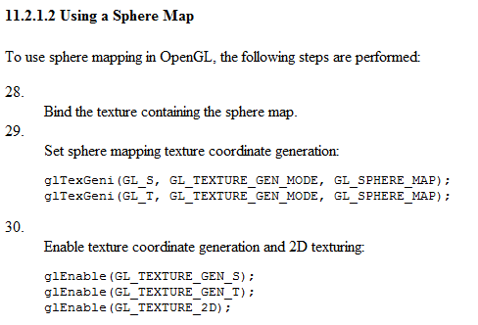

Slide 51
